Slide 1
Lecture # 7A
20 October 2020
Dr. A. Upadhyaya TA201: Introduction to Manufacturing Processes

Slide 2
Imperfections in Crystalline Solids
Dr. A. Upadhyaya TA201: Introduction to Manufacturing Processes

Slide 3
IMPERFECTIONS IN CRYSTALLINE SOLIDS
• What types of defects arise in solids?
• Can the number and type of defects be varied
and controlled?
• How do defects affect material properties?
• Are defects undesirable?

Slide 4
TYPES OF IMPERFECTIONS
• Vacancy atoms
• Interstitial atoms
• Substitutional atoms
Point defects
Line defects
Area defects
• Dislocations
• Grain Boundaries

Slide 5
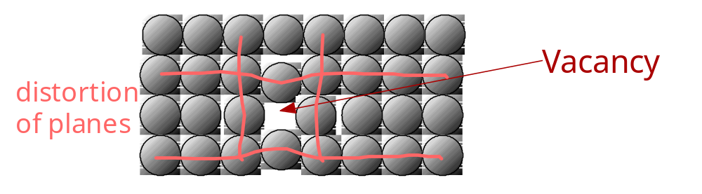
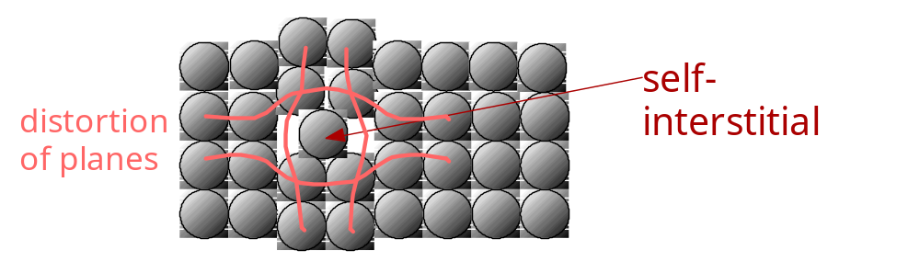
POINT DEFECTS
• Vacancies:
-vacant atomic sites in a structure.
• Self-Interstitials:
-"extra" atoms positioned between atomic sites.

Slide 6
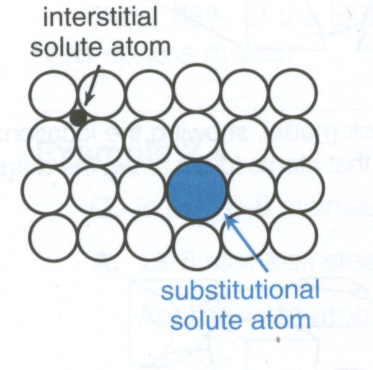
Substitutional and Interstitial Solid-Solution Alloys

Slide 7
For more details, please refer to the slides on interstitial solid-solution alloys which also describe the octahedral and tetrahedral sites in bcc and fcc crystals

Slide 8
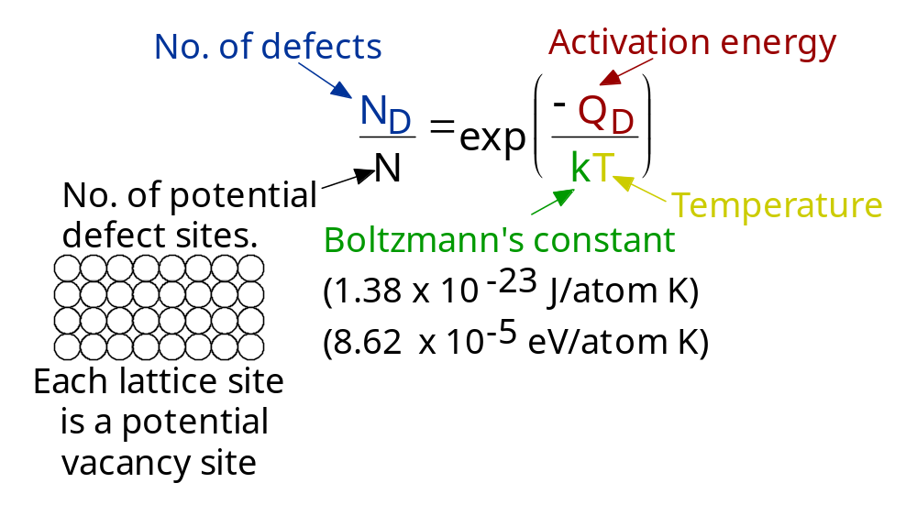
EQUIL. CONCENTRATION: POINT DEFECTS
• Equilibrium concentration varies with temperature!

Slide 9
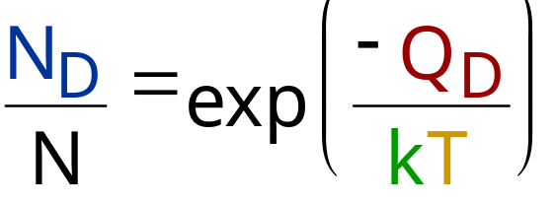
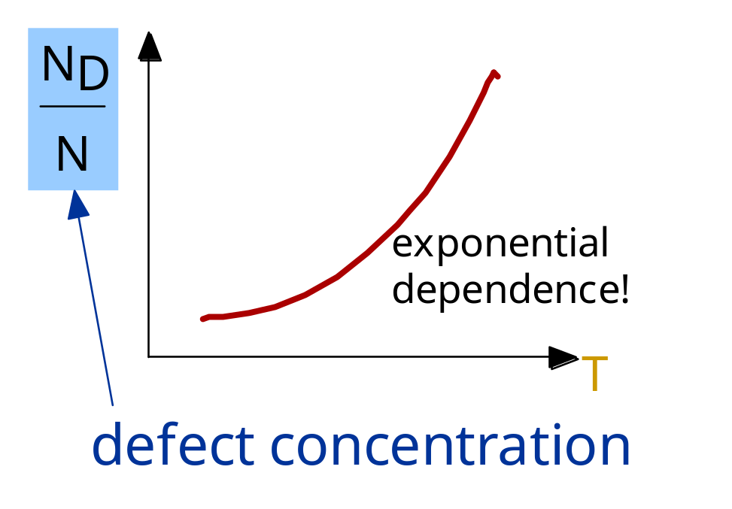
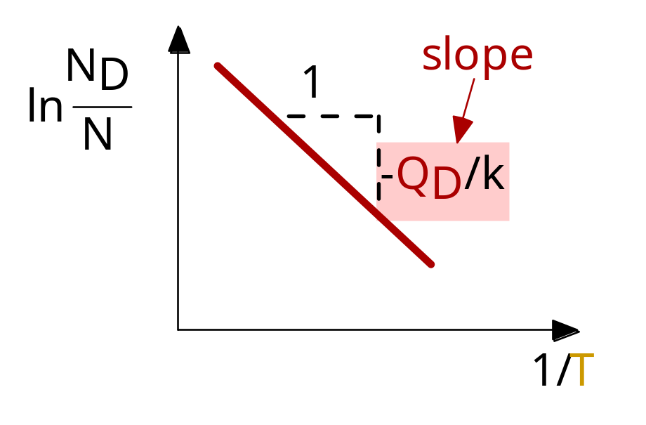
MEASURING ACTIVATION ENERGY
• We can get Q from
an experiment.
• Measure this...
• Replot it...

Slide 10
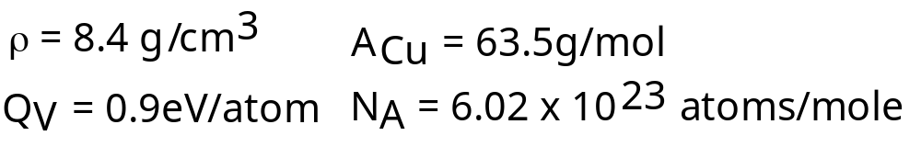
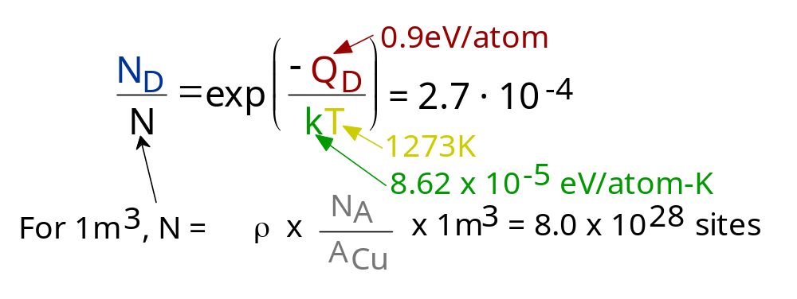
ESTIMATING VACANCY CONC.
• Find the equil. # of vacancies in 1m³ of Cu at 1000C.
• Given:
• Answer:

Slide 11
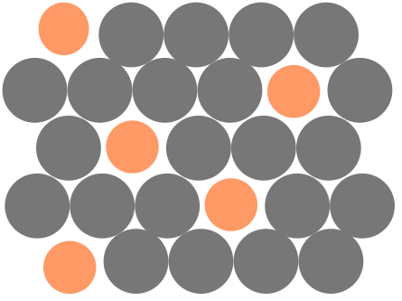
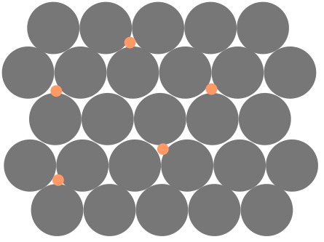
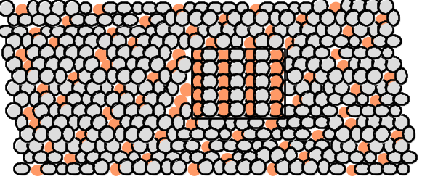
POINT DEFECTS IN ALLOYS
Two outcomes if impurity (B) added to host (A):
• Solid solution of B in A (i.e., random dist. of point defects)
OR
Substitutional alloy
(e.g., Cu in Ni)
Interstitial alloy
(e.g., C in Fe)
• Solid solution of B in A plus particles of a new
phase (usually for a larger amount of B)
Second phase particle
--different composition
--often different structure.

Slide 12
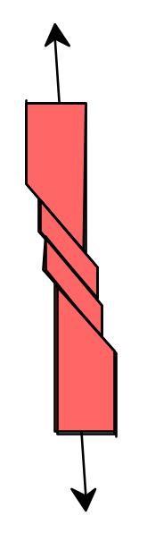

LINE DEFECTS
Dislocations:
• are line defects,
• cause slip between crystal plane when they move,
• produce permanent (plastic) deformation.
Schematic of a Zinc (HCP):
• before deformation
• after tensile elongation
slip steps

Slide 13
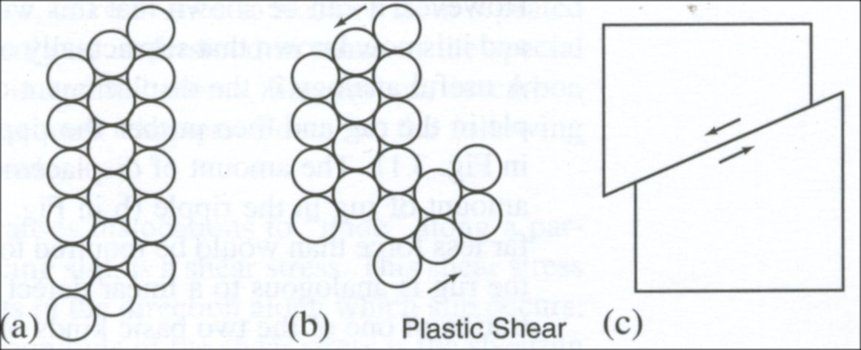
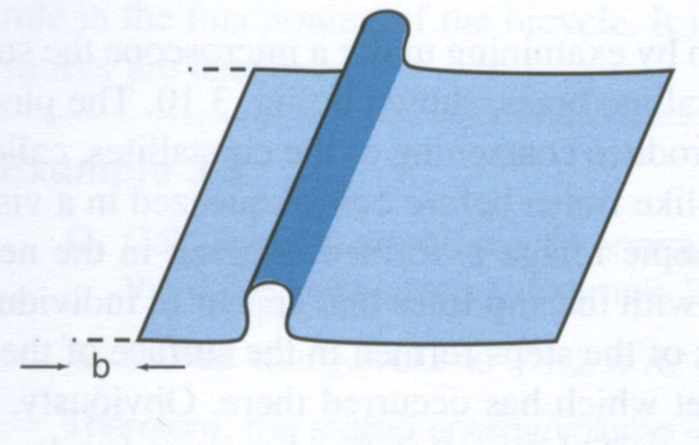
Plastic Shear in a Crystal

Slide 14
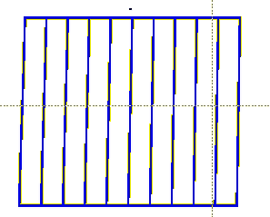
INCREMENTAL SLIP
• Dislocations slip planes incrementally...
• The dislocation line (the moving red dot)...
...separates slipped material on the left
from unslipped material on the right.
Simulation of dislocation
motion from left to right
as a crystal is sheared.

Slide 15
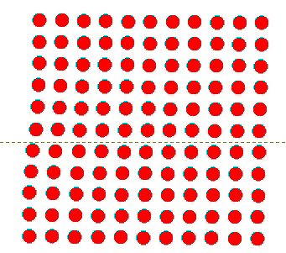
BOND BREAKING AND REMAKING
• Dislocation motion requires the successive bumping
of a half plane of atoms (from left to right here).
• Bonds across the slipping planes are broken and
remade in succession.
Atomic view of edge
dislocation motion from
left to right as a crystal
is sheared.

Slide 16
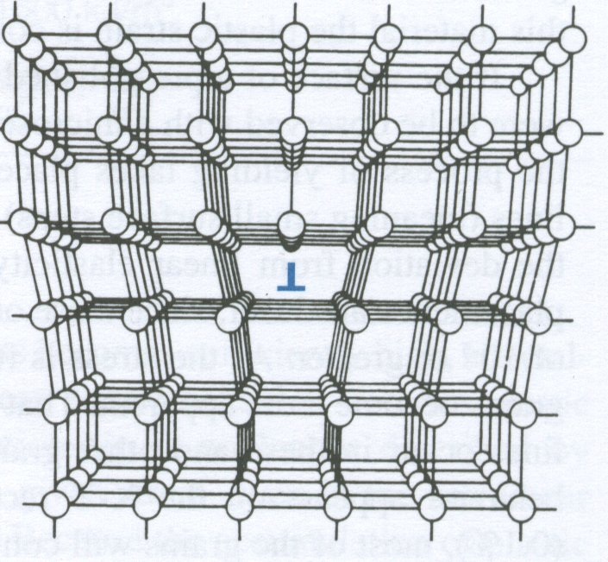
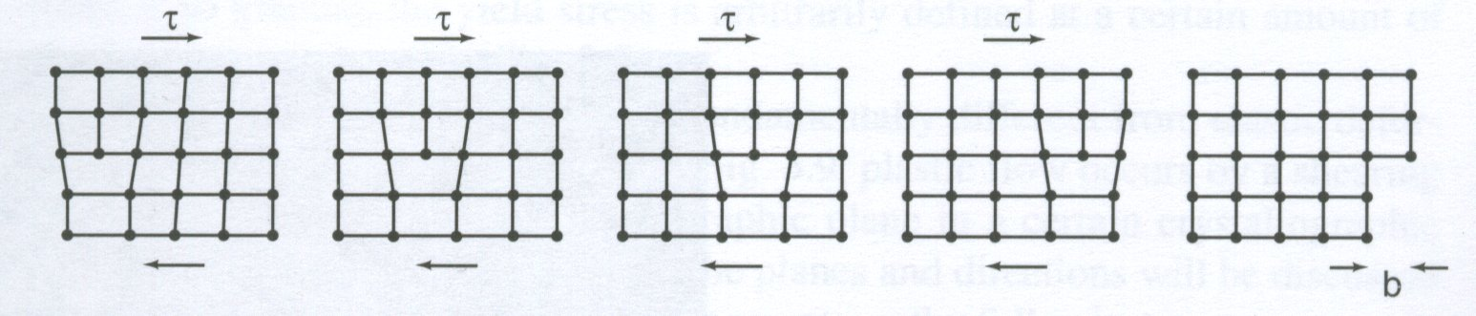
Edge Dislocation in the Crystal
glide of an edge dislocation

Slide 17
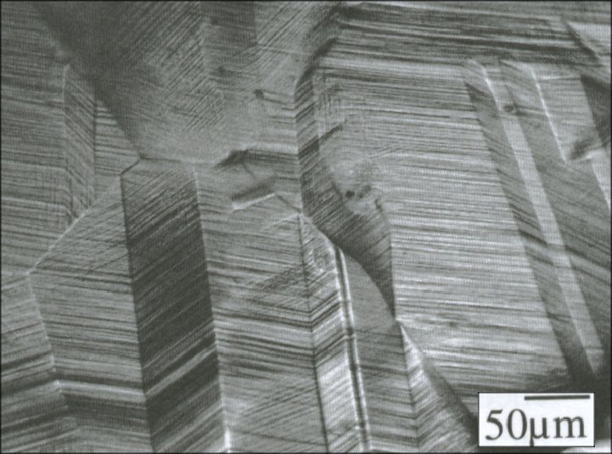
Brass Cu-10Zn
The surface of a pre-polished, coarse-grained piece of brass
after being squeezed in a vise to produce abundant slip.

Slide 18
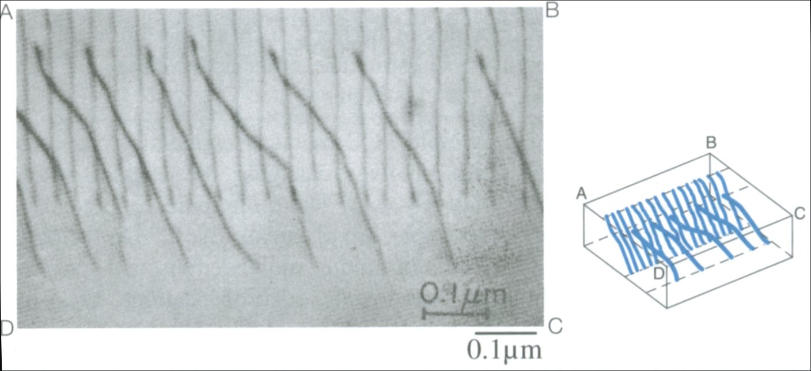
Dislocation

Slide 19
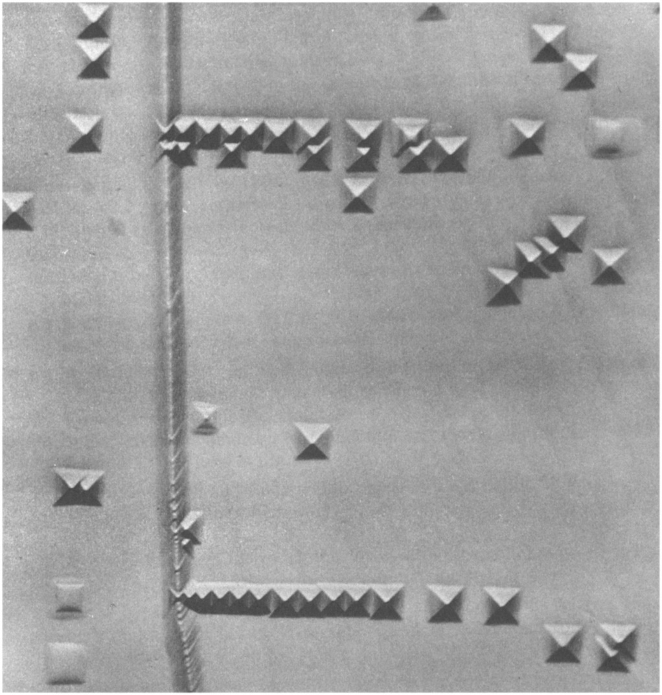
Edge Dislocation in LiF Single Crystal

Slide 20
Slip occurs in the closed backed plane and along the close-packed direction

Slide 21

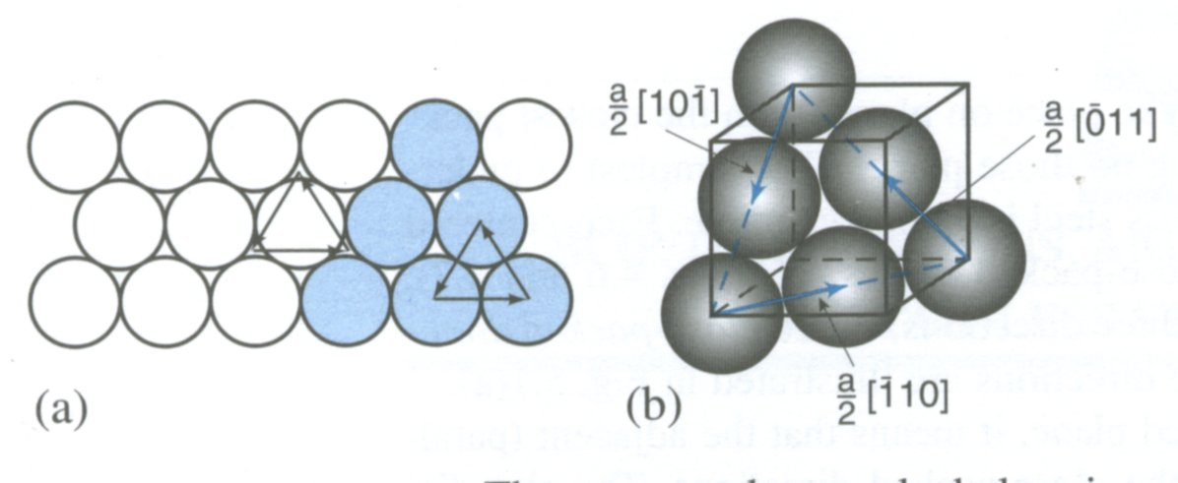
DISLOCATIONS & CRYSTAL STRUCTURE
• Structure: close-packed
planes & directions
are preferred.
view onto two
close-packed
planes.
Slip vectors in FCC Crystal

Slide 22
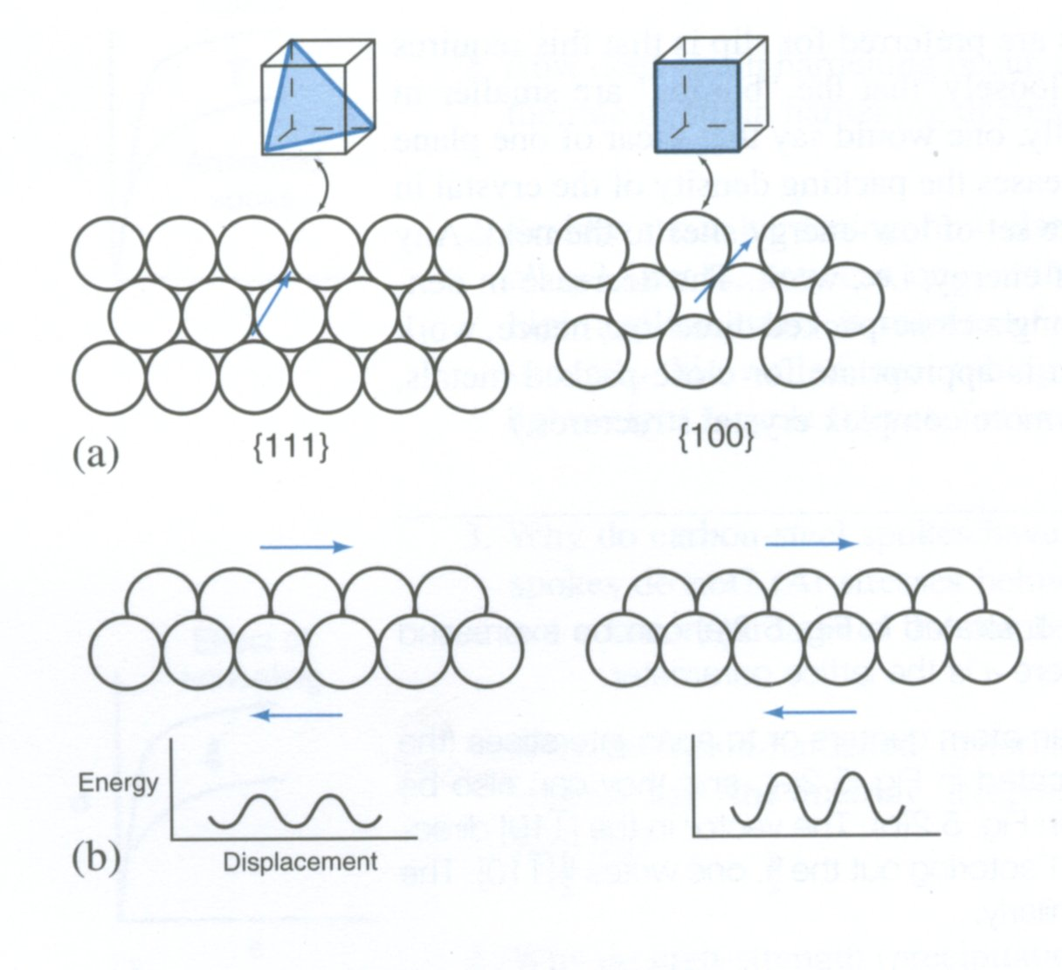

Slide 23
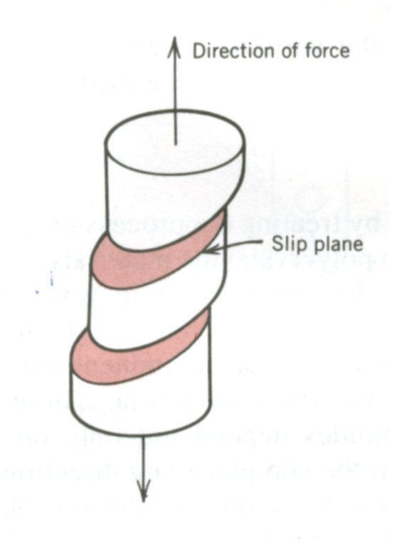
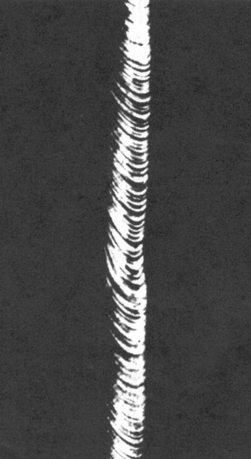
Slip vectors in HCP Crystal
slip in Zn single crystal

Slide 24
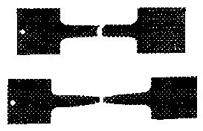
• Comparison among crystal structures:
FCC: many close-packed planes/directions;
HCP: only one plane, 3 directions;
• Results of tensile
testing.
Mg (HCP)
tensile direction
Al (FCC)

Slide 25
Slip occurs in the closed backed plane and along the close-packed direction.
Presence of dislocations aids in slipping.
However, as the plastic deformation continues, dislocations tend to multiply
An increase in the dislocation density implies that the dislocations with interact with each others. Often times, this leads to dislocation interlocking. Hence, to cause further deformation, the stress needs to be increased. This is known as strain hardening.
As the dislocations density increase with further deformation, the increased dislocation density implies a reduction in the overall ductility of material.

Slide 26
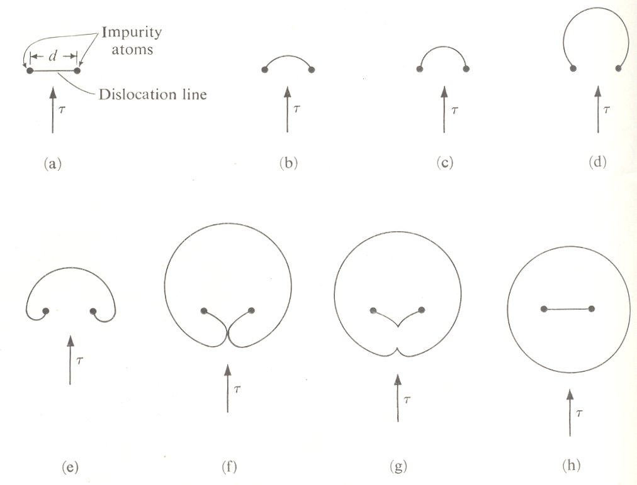
How Do Dislocations Multiply?
Frank-Read Source

Slide 27
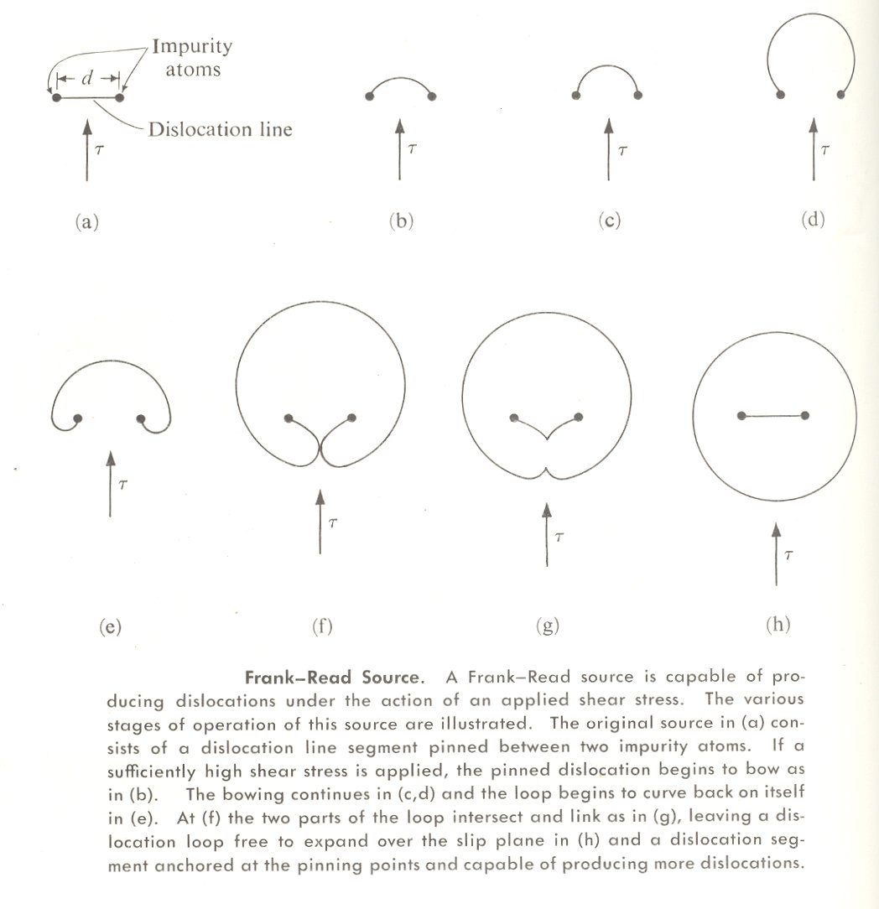

Slide 28
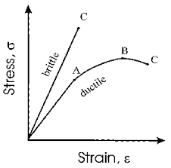

Slide 29
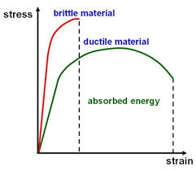

Slide 30
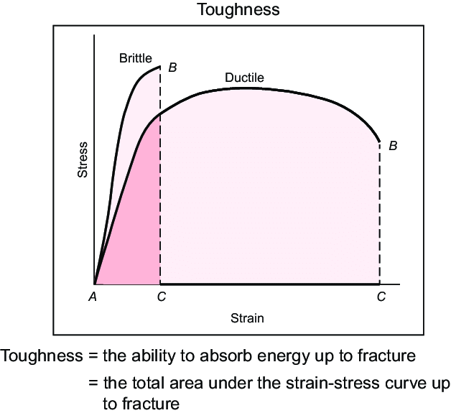

Slide 31
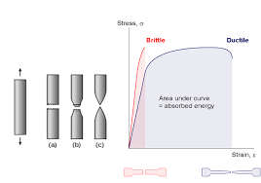
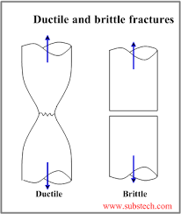
brittle
moderate ductility
very high ductility

Slide 32
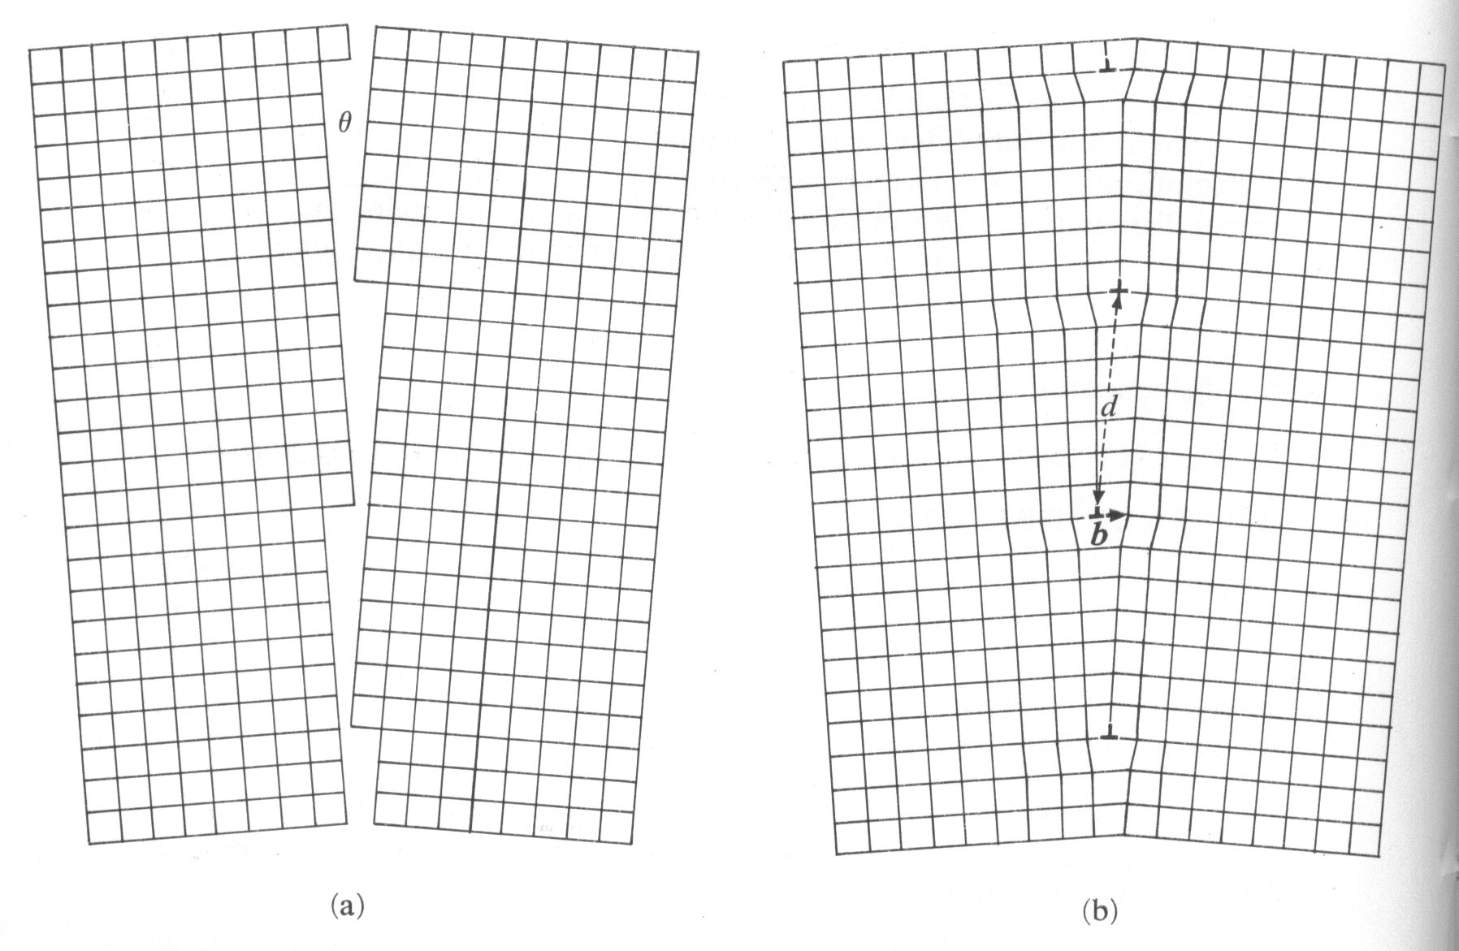
An array of dislocations stacked together constitute grain boundary
Low-Angle Grain Boundary

Slide 33
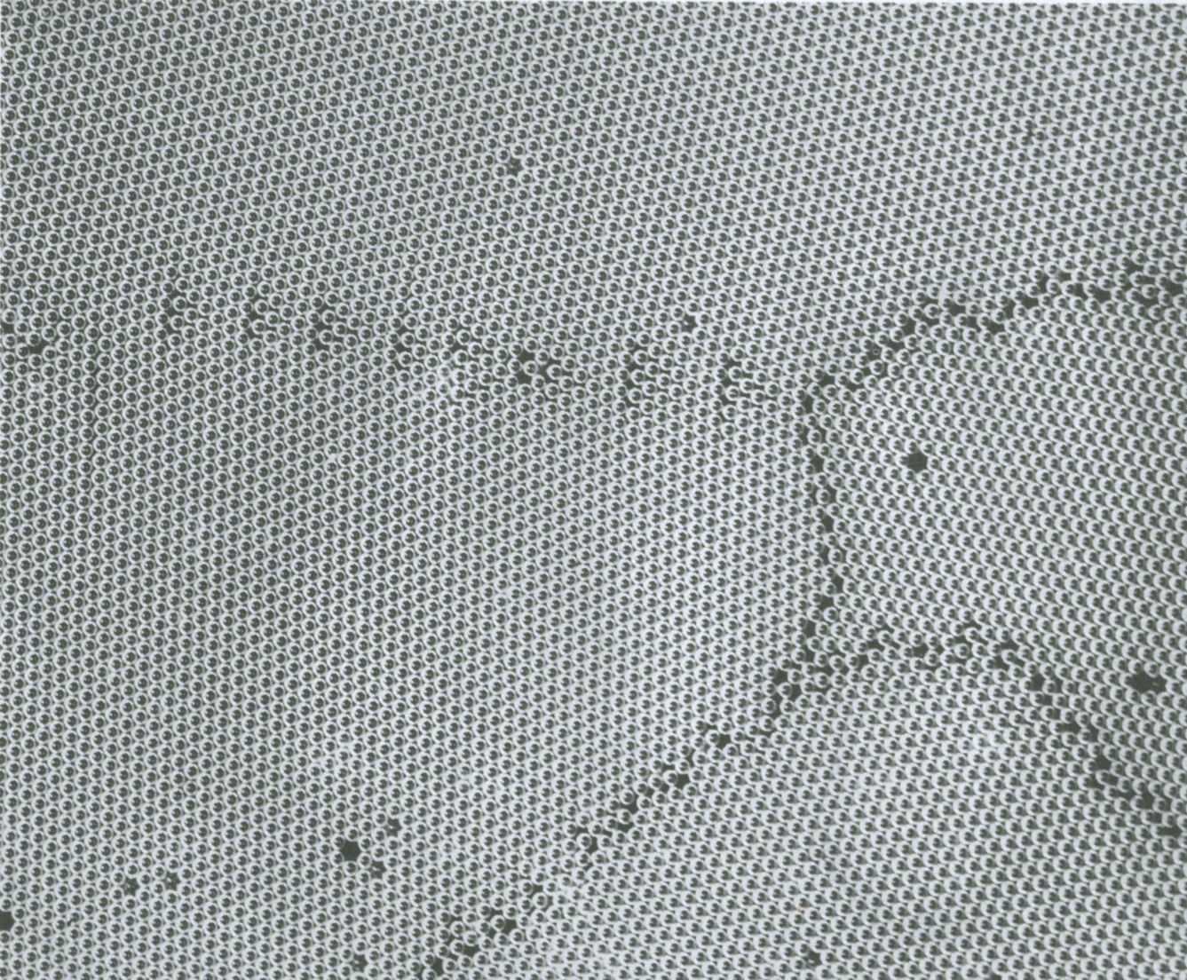
A 2D analog of a polycrystal, made of bubbles, showing
the varying degree of atomic disorder

Slide 34
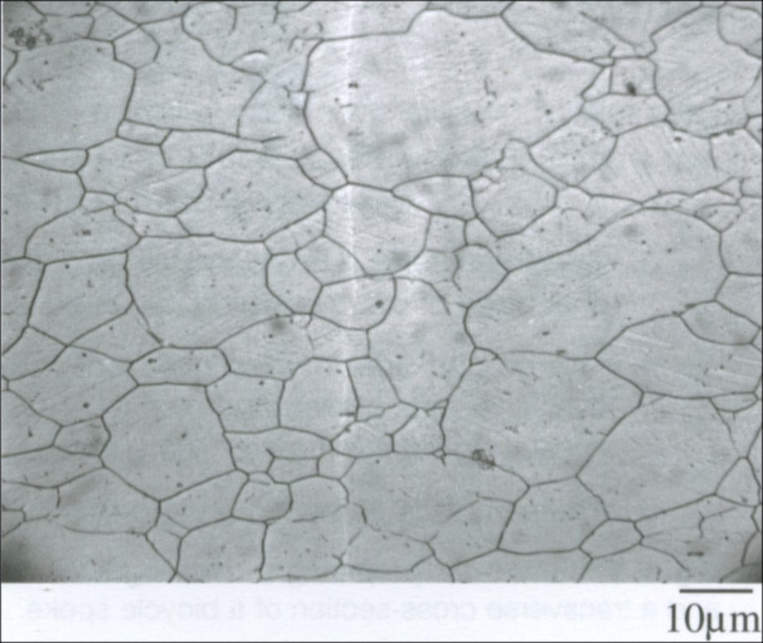
Microstructure of Stainless Steel

Slide 35
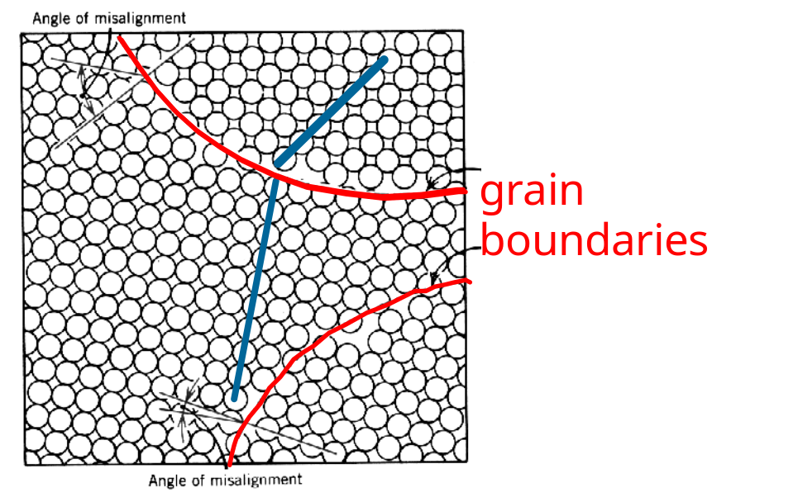
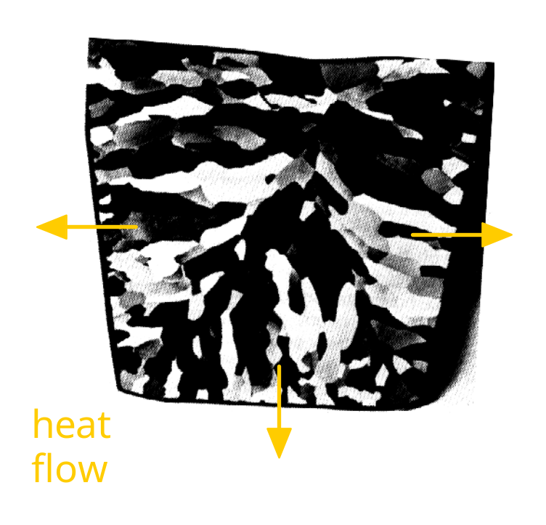
AREA DEFECTS: GRAIN BOUNDARIES
Grain boundaries:
• are boundaries between crystals.
• are produced by the solidification process, for example.
• have a change in crystal orientation across them.
• impede dislocation motion.
Metal Ingot
Schematic
~ 8cm

Slide 36
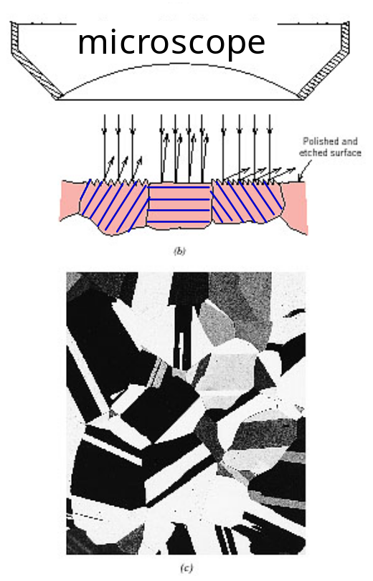
On of the ways to visualize grain boundary is through optical microscopy
• Optical Microscopy useful up to 1500x magnification.
• Polishing removes surface features (e.g., scratches)
• Etching changes reflectance, depending on crystal
orientation.
close-packed planes
micrograph of
Brass (Cu and Zn)
0.75mm

Slide 37
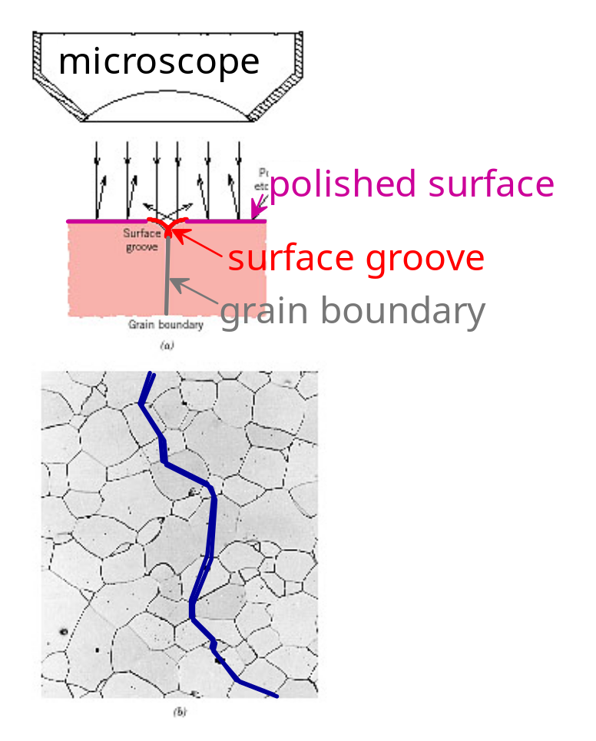
Visualization of Grain Boundary by Optical Microscopy
Grain boundaries...
• are imperfections,
• are more susceptible
to etching,
• may be revealed as
dark lines,
• change direction in a
polycrystal.
Adapted from Fig. 4.12(a) and (b), Callister 6e.
(Fig. 4.12(b) is courtesy
of L.C. Smith and C. Brady, the National Bureau of Standards, Washington, DC [now the National Institute of Standards and Technology, Gaithersburg, MD].)

Slide 38
SUMMARY
• Point, Line, and Area defects arise in crystalline solids.
• The number and type of defects can be varied
and controlled (e.g., T controls vacancy conc.)
• Defects affect material properties (e.g., dislocations
and grain boundaries control crystal slip).
• Defects may be desirable or undesirable
(e.g., dislocations may be good or bad, depending
on whether plastic deformation is desirable or not.)

